Slide 1
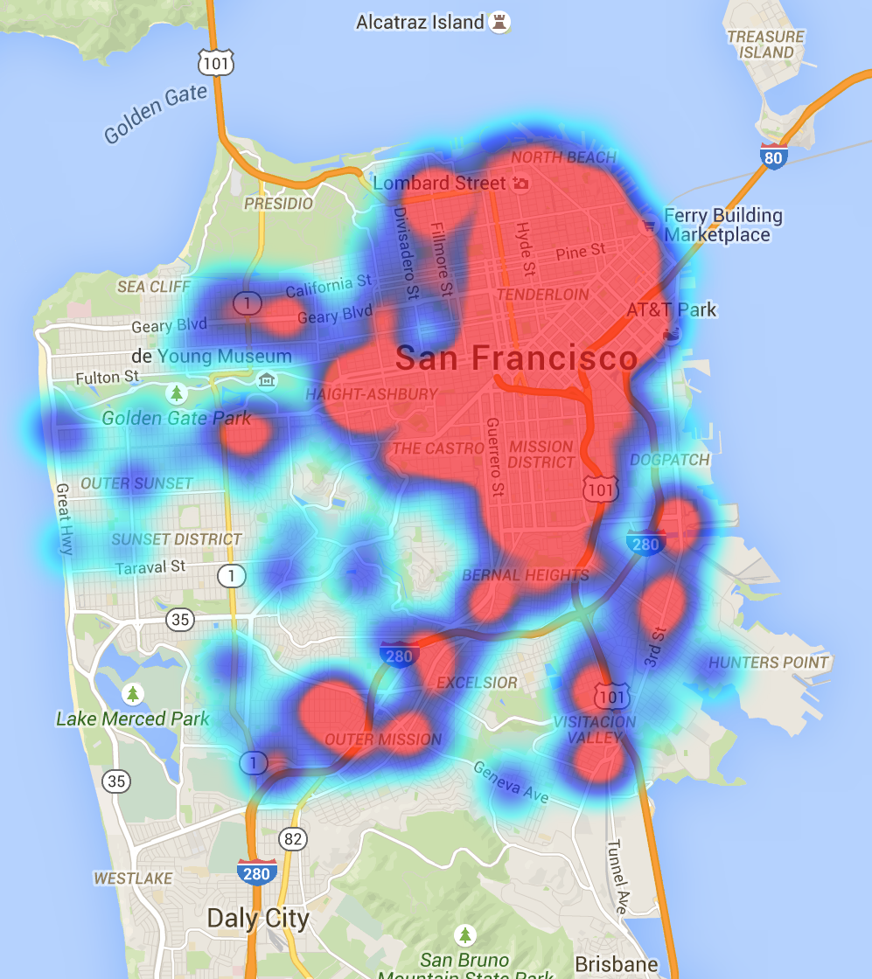
San Francisco Crime
Analysis
Akashdeep balu (hc6943)

Slide 2
Agenda
Introduction
Problem Statement
Feature Selection
Data Preprocessing and Description
Exploratory Data Analysis
Methodology and Implementation
Conclusion

Slide 3
Introduction
San Francisco has one of the highest crime rates in the United States of America compared to all communities of all sizes - from the smallest towns to the very largest cities.
For every 100,000 people, there are 18.86 daily crimes that occur in San Francisco.
San Francisco is safer than 5% of the cities in the United States.
In San Francisco you have a 1 in 15 chance of becoming a victim of any crime.
The number of total year over year crimes in San Francisco has not changed.

Slide 4
Problem Statement
To categorize the different types of crime in San Francisco crime data set.
Source- https://www.kaggle.com/c/sf-crime
Build a classifier to predict the crime category.
Build a clustering model using various features to predict the category of the crime.

Slide 5
Feature Selection
The values in the dataset are detailed and does not contain any null values. However it’s hard to determine the relationship between crime classes, hence additional information regarding the location is taken from Zip data set.
Few variables like geohash and population were considered from Zip-data set.
The category had 39 crime classes were reduced to 10 for better performance of the models.
I have added new columns such as season and hour by extracting from column 'Dates'.

Slide 6
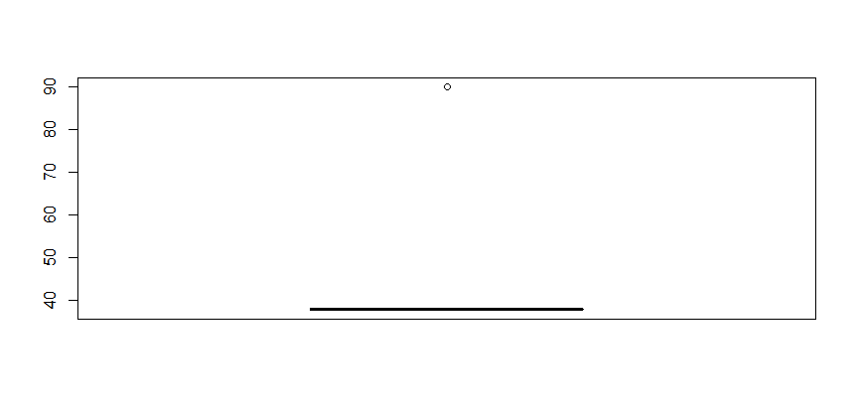
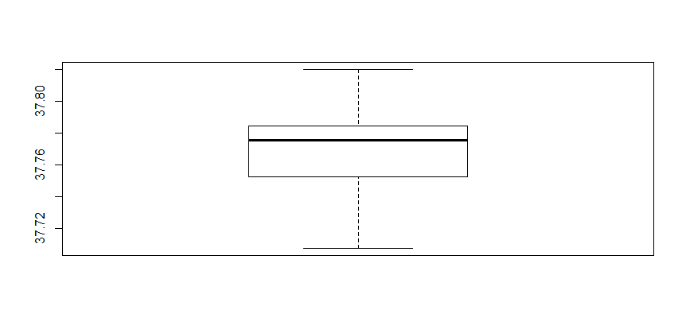
Data Preprocessing
Removal of outliers from the SF Crime dataset

Slide 7
Data Set Description
Date​​s: The timestamp of the crime recorded.​​
Category​​: The category of the crime records​​
Descript​​: A short note on the crime.​​
DayOfWeek​​: The day on which the crime took place.​​
PdDistrict​​: The police department, under which the crime is reported.​​
Resolution​​: The status of the crime, resolved or unresolved.​​
Address​​: The address of the crime scene.
Season: Seasons information of the month.
Geohash: To encode latitude ,longitude & grouping nearby points on the globe.
Zip : Zip-code of the area where the crime was reported.
Lat: The latitude of the crime scene.
Lng: The longitude of the crime scene.
Population: The total population of area zipcode covers.
Hour: The hour at which the crime took place.

Slide 8
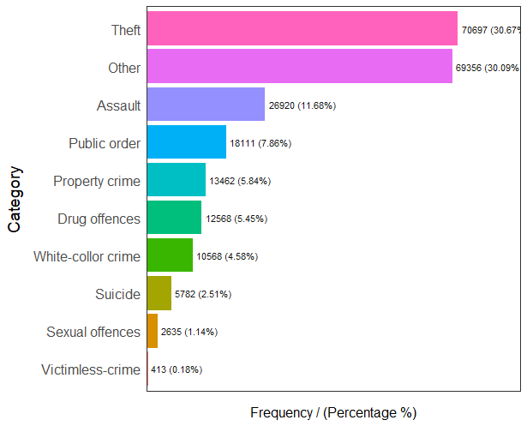
Exploratory Data Analysis
Category:
These are the target label/crime we want to predict. I observed 39 crime categories which I have further scaled them to 10.

Slide 9
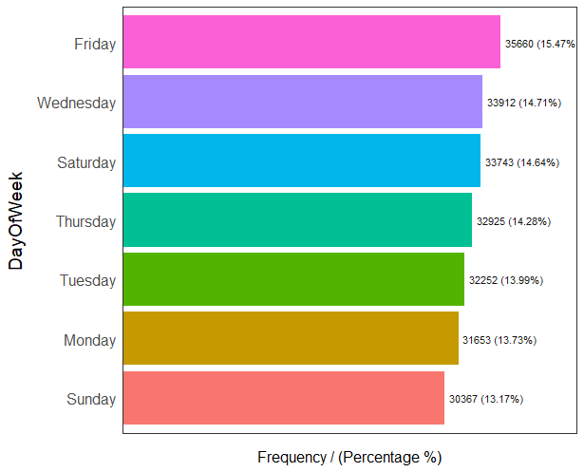
Exploratory Data Analysis
Day Of Week
Crimes seem to be almost evenly distributed across days of the week.
Although, there is a slight increase on Fridays.

Slide 10
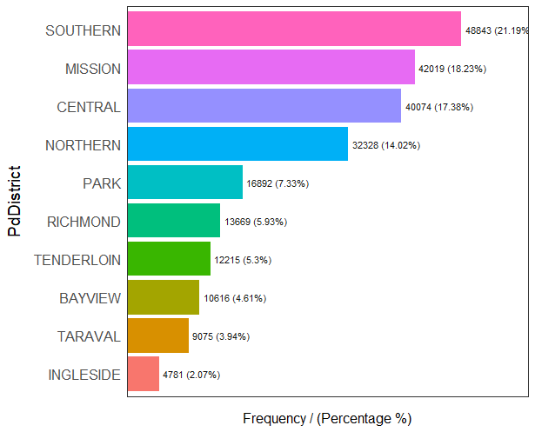
Exploratory Data Analysis
PdDistrict
Number of Crimes reported for Each Police Department District.
There are 10 districts in San Francisco. Some of them are more endowed with crimes than others.

Slide 11
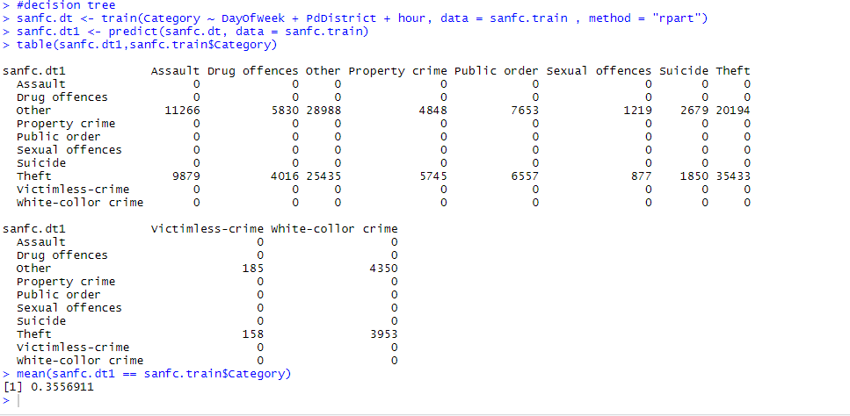
Methodology and Implementation
Decision Tree
I have built classification models using various features to predict the category of crime

Slide 12
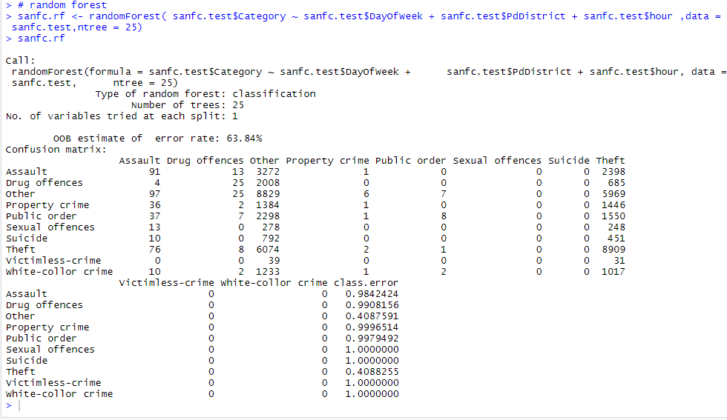
Random Forest
Error Rate observed applying random forest with number of trees as 25 is 63.84%

Slide 13
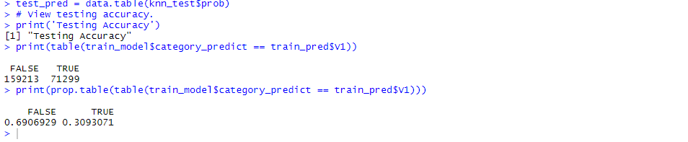
K- Nearest Neighbor:
I have scaled the predictors “Lat”,“Lng” and "hour".
Further, added the variables to build a model for better classification.

Slide 14
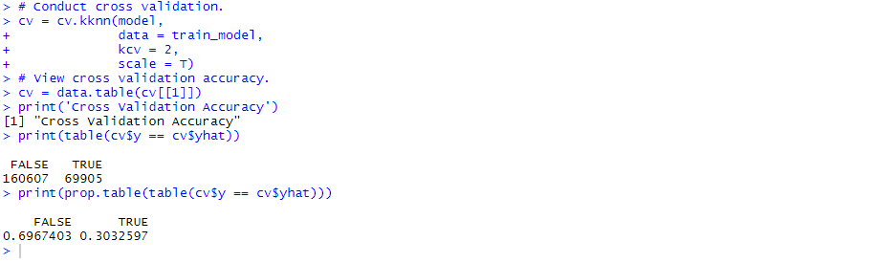
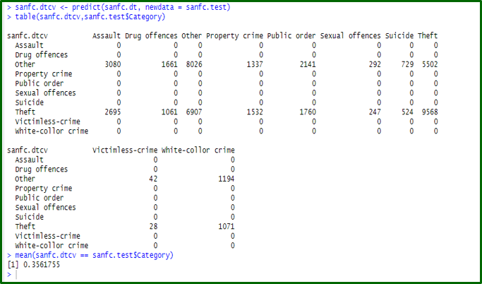
Cross validation

Slide 15
Conclusion
The dataset is highly random, and the predictors were less likely related to the type of crime. However, categorizing the predictors and crime improved the performance of the model slightly.
The reason for low accuracy of models can be collinearity of the type crime happening in same geographical area which made it difficult to classify the type of crime for model.
In other words a different crimes can happen in same geo location making it difficult for model to differentiate between the type.
Thus, we can conclude from the above results and plots, that the type of the crime is less likely dependent of the external factors such as day, time and location.

Slide 16

Thank You

